Slide 1
Testing and Design
Phil Pfeiffer
April 2013

Slide 2

Planning for Testing: Rationale

Slide 3
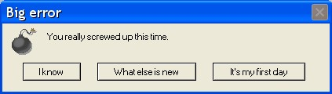
Planning for Testing: Rationale
"Pay me now" is usually far cheaper than "Pay me later".

Slide 4
Starter Concepts: Strategies
black box testing
tests to specifications
assumes ignorance of module internals
white (clear) box testing
tests along all code paths
assumes full knowledge of module internals
gray box testing
tests to specifications
assumes some knowledge of key internals, inputs more likely to provoke errors

Slide 5
Starter Concepts: Granularities
unit testing
testing a program's basic elements in isolation
integration testing
testing interacting units
system testing
testing overall system operation
acceptance testing
testing if user agrees that system meets its requirements

Slide 6
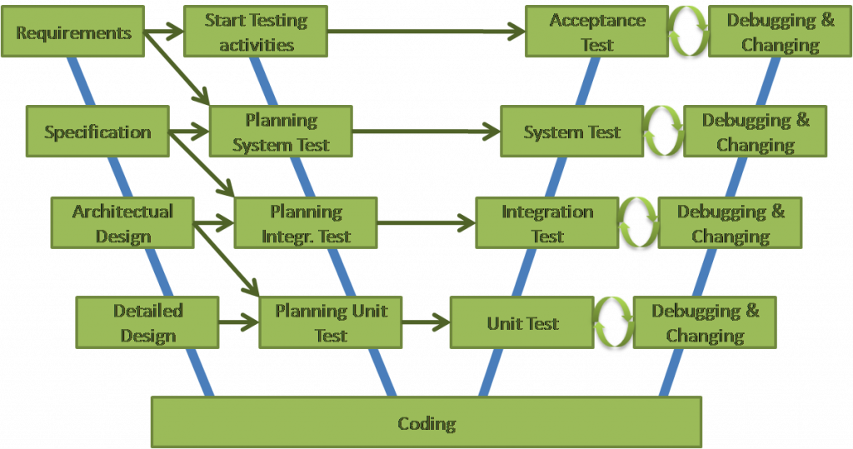
Starter Concepts: Test Phases

Slide 7
Starter Concepts: Test Phases
Planning Acceptance Testing

Slide 8
Starter Concepts: Test Phases known as the W-model

Slide 9
Starter Concepts: Test Phases "early start" version of V-model

Slide 10
Initial Testing: Traceability
Bidirectional matching of requirements, design
Do architecture, design account for all requirements? (completeness)
Do architecture, design address just requirements? (minimality)
Assessing departures from requirements
May be acceptable
Permissible (resource limitations)
Desirable (flexibility)
Should be accounted for!

Slide 11
Later Testing: Execute and Verify
Test case
sequence of test values and expected results
Test script
creates environment for test, creates necessary objects, runs tests
Test suite
group of test scripts that achieve some level of coverage, e.g. functional suite to test all class specs
Best practice: where possible, automate

Slide 12
Alternative: Formal Methods
Idea: automate testing with theorem proving
Desired operation modeled using formal semantics
Axioms
State spaces
Initial program state, potential operation modeled from source code
Prover uses "synthetic execution" to analyze possible behaviors relative to desired operation
In limited use today
Some dramatic successes

Slide 13
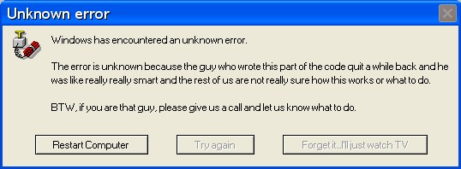
Designing for Testability: What to Avoid

Slide 14
Designing for Testability: How
Goal: Design code for S.M.A.R.T. testing
specific (one aspect of behavior)
measurable (pass-fail)
attainable (can be coded somehow)
realistic (can be coded in practice)
timely (can be run as needed - i.e., automated)
Strategy: clear requirements, design, code

Slide 15
Best Practices (Discussed so Far)
For methods
Highly cohesive in purpose
Functional cohesion
name: concrete verb + concrete noun
preconditions, invariants, postconditions
Low fan-out
Concise
Page or less
Low cyclomatic complexity
Loosely coupled
Null or data (best)
Stamp (for massive datasets)

Slide 16
Best Practices (Discussed so Far)
For classes
Highly cohesive in name
As a rule, concrete noun
For mixins, concrete quality
Concise focus
Common domain
Single role
Single instance
Loosely coupled
Interface defines functionality
API hides implementation

Slide 17
Best Practices (Discussed so Far)
For neighborhoods / components
Highly cohesive in name (concrete noun)
Concise focus
Common use (use one => use all)
Common closure (change one => change all)
Loosely coupled
Interface defines functionality
API hides implementation

Slide 18
Best Practices (Discussed so Far)
For dependencies, address circularities
Best: break them
Factor common logic in cycle into additional module
Promote/ demote additional module, depending on whether logic
Was called by original routines, or
Drove original routines' operation
Alternative: tame, using opaque pointers/ data types
Allows for
initial testing of 1st module in circularity with null 2nd object
then testing of 2nd module with non-null 1st object
then retesting of 1st module with non-null 2nd object
See http://en.wikipedia.org/wiki/Opaque_pointer, http://en.wikipedia.org/wiki/Opaque_data_type

Slide 19
Test Design
Test logic is also logic
Design considerations in play, as well

Slide 20
Feathers on Unit Test Design
A test is not a unit test if
1. It talks to the database
2. It communicates across the network
3. It touches the file system
4. It can't run correctly at the same time as any of your other unit
tests
5. You have to do special things to your environment (such as
editing config files) to run it.
Tests that do these things aren't bad …. However, it is important to be able to separate them from true unit tests so that we can keep a set of tests that we can run fast ….
Feathers, Michael, "API Design as if Unit Testing Mattered", SD West 2007

Slide 21
Design and Unit Testing
Tailor black-box tests to pre-, post-conditions
What to test for
Explicit rejection of invalid preconditions, as required by specifications
Proper discharge of postconditions for valid inputs
How to test
Equivalence classes, where possible
Boundary case coverage particularly critical

Slide 22
Design and Unit Testing
Tailor gray-box tests to preconditions, postconditions, special knowledge
Black-box testing, plus
Special cases implied by special knowledge
Invariants should suggest special cases

Slide 23
Design and Unit Testing
Tailor white-box test cases to control flow
Use inputs that assure all-paths coverage, including
paths through if-then-elsif statements
paths through select statements
exception clauses
Can be quite difficult to achieve
Flow graphs can help with test design

Slide 24
Design and Testing: Hevery
Treat tests as executable specifications
Could you reconstruct your code if you erased it and were left with only your tests?
(Reminds me of test-driven design)
Bad practices with respect to testability
Explicit object allocation – i.e., new() is dangerous
Doing work in object constructor
Reliance on global state
Access to unneeded state (i.e., breaking Demeter)
Mixing core logic, communications, rendering
Misko Hevery, "How to Write Clean, Testable Code", Google Tech talks, Dec. 2010

Slide 25
Myers' Checklist for Testing
#input parameters = #arguments?
Parameter - argument attributes match? (type, units)
Value parameters altered?
File attributes correct?
Files opened? Closed?
Buffer size matches record size?
End of file conditions handled?
Other I/O errors handled?
Initialization/default values correct?
Underflow/overflow handled?

Slide 26

Testability and Doug Adams
Someone or something seemed to be expecting him, for at that moment there lit up suddenly in the dark distance an eerie green neon sign. It said, silently: YOU HAVE BEEN DIVERTED..., ARTHUR DENT. WELCOME, I DON'T THINK. DO NOT BE ALARMED. BE VERY, VERY FRIGHTENED, ARTHUR DENT.
Doug Adams, Life, The Universe, and Everything, chapter 18

Slide 27
Advice from Years of Development
When you invoke logic beyond program's control
Don't be alarmed
Be very very paranoid
Includes environmental resources, data sources
Anticipate the API's failure, even if you know that failure is "impossible"
Add an explicit error check, always
Include a self-explanatory error message, always
These errors can and do happen
These errors are killers, in terms of time to debug

Slide 28
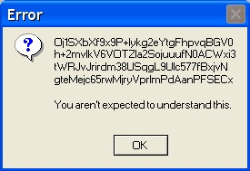
On Message Design

Slide 29
Message Design: My Advice
Engineer different anomaly messages for users, admins
Users need to know what to do
How to proceed, who to contact
Expressing details may confuse, compromise design security
Admins need to know circumstances of anomaly
Context of problem: date/time, affected module(s)
What assertion(s) were violated
Expected state vs. error state
What might have gone wrong
Make message design part of architecture
Standardize header
Indicate severity: advisory/ warning/ error/ fatal
Separate the two kinds of messages
Return different messages to different users
Alternative: use log to capture messages for admins

Slide 30
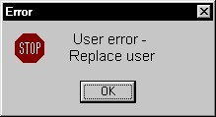
Testing for Usable Designs
Important , but beyond scope of these notes

Slide 31
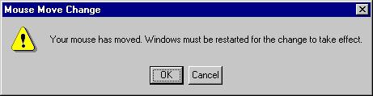
Questions?

